Slide 1
Total Recall –Credit Risk
•Challenge to Define Default in the Context of India
•Choosing Logistic over Discriminant Models to predict Default
•Need to Find ‘independent’ attributes / features to predict Default
•Understanding and Cleaning of Data is Essential
•Dividing the Sample in Development, Validation, Out of Sample Validation is a Must.

Slide 2
Agenda
•How Credit Decisions are Taken in the Financial Industry?
•How is Machine Learning Being Adopted in Taking the Decisions?

Slide 3
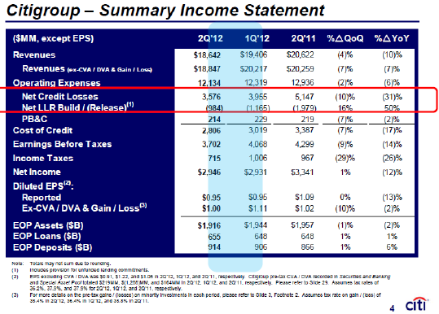
Why Credit Risk?
•Net Credit Loss : 25% of Revenues and Twice the net income in Q2 2011

Slide 4
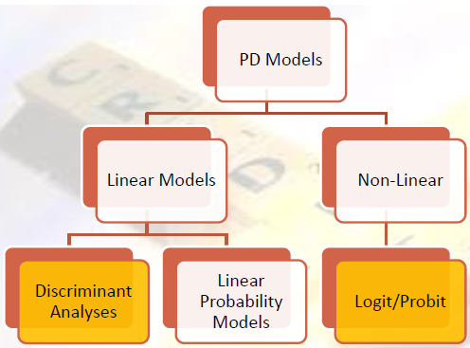
PD Models -Statistical
Models in Credit Risk Measurement

Slide 5
How do you build a
Default Model for India
•Defining Default –Some considerations
–It Should Work
–Easy to Define
–Easy to Apply and Measure
–Lend to Future Improvement

Slide 6
Pages in Indian ‘Default’ History
•Sick Industrial Company Act (SICA, 1985)
–Registered for Five* Years
–Incurred Cash Loss for two consecutive years
–Networth is negative
•Eligible Company Mandatorily refer to BIFR (Board for Industrial and Financial Reconstruction)

Slide 7
Pages in Indian
‘Default’ History (Continued)
•Sick Industry Report (1992)*
-Evaluated Criteria Independently
-Recommended using 2 years of consecutive Cash Flow as the Criteria
-Rationale –Early Intervention has chances of High Survival of the Sick Companies

Slide 8
Does this Default Definition Work?
•Year 2007 : PAT of a company was -60.7 crores
•Year 2008 : PAT of a company was -97.4 crores
•Shall we define this company as a Defaulter / Sick Company ?
•Net worth of the company was positive though in these two years
•Name of this company : TATA Advanced Material Ltd
•TATA Advanced Material Ltd sprung back to action
with positive profit in the later years

Slide 9
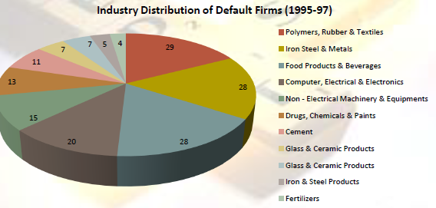
Proposed Definition
•Companies which has Negative Networth for the First timein the Time window 1991-97
–Midway between the Two Definitions
–Is Measurable and can be Improved

Slide 10
PD Models –Linear Models
•Altman’s Z Score Model (1968)
•Z (Public) = 1.2X(1) + 1.4X(2) + 3.3X(3) + 0.6X(4) + 1.0X(5)
–Where Z > 2.99 is healthy
–Z < 1.81 is unhealthy
–1.81 < Z < 2.99 is indeterminate
•X(1) = Working Capital / Total Assets
•X(2) = Retained Earnings / Total Assets
•X(3) = Earnings Before Interest and Taxes (EBIT) / Total Assets
•X(4) = Market Value of Equity / Total Assets
•X(5) = Net Sales / Total Assets

Slide 11
Steps to Build a Good Function
•Selection of the ‘Default’ Sample
•Creation of the Non-Default Sample
–Choice of Industry, Firm Size & Time Period
•Appropriate Treatment of the Data
–Choose the predictors carefully
•Choice of a Good Out of Sample Validation Data –Stress Test the Data

Slide 12
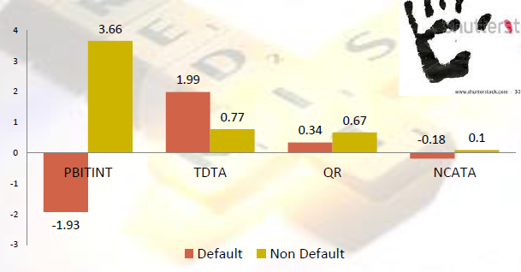
Deep Dive on the Variables
•Clear Separation in mean values of variables between defaulters and non-defaulters

Slide 13
Discriminant Function
•India Z Score Model (2000)
•Z (Public) = 1.06 + 0.01PBITINT –3.12TDTA + 0.48QR + 4.61NCATA
•PBITINT = Profits Before Interest & Taxes / Total Interest
•TDTA = Total Borrowings / Total Assets
•QR = Current Assets –Inventories / Current Liabilities & Provisions
•NCATA = Profit After Tax & Depreciation / Total Assets

Slide 14
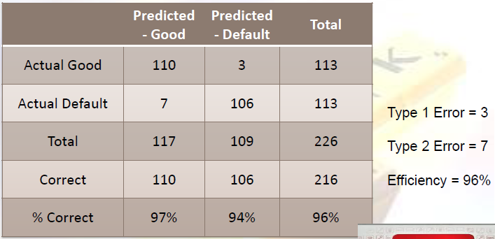
Does it Work ?

Slide 15
Challenges of Discriminant Model
•Challenges
–Zone of Indifference (Indeterminate)
–Sensitivity to Industry
–Dealing with New Companies
–Loss of Predictive Power across Time –use of Penalty Functions
–Multi-colinearity of Variables
•Some variables provide the same information and are highly correlated
–Assumption of Multivariate Normality of Variables

Slide 16
What if we use a
Logistic Framework?
•We can also Build a Logistic Model using 2010-11 Data
•Take all companies with negative Net worth in 2011
•Take the same number of companies with similar asset size and same industry with positive Net worth in 2011
•QC the data carefully, removing all outliers
•Compute all the predictors as of 2010
•Run the logistic regression and get the equation

Slide 17
Logistic Model -The new Equation
•Logit(score) = -6.9965
+ 4.8879 *Total Borrowings/Total Assets
-0.455 * Net working cap / Current Liabilities
-6.8605 *Net cash accruals / Total assets
+1.6317 *Current Liabilities / Current Assets
+ 0.1978 *Total Borrowings/Total Liabilities

Slide 18
Logistic Models –
Use in Credit Rating
•If we run the equation on N companies, we can rank-order the companies based on the score
•Create ratings based on the cutoffs chosen

Slide 19
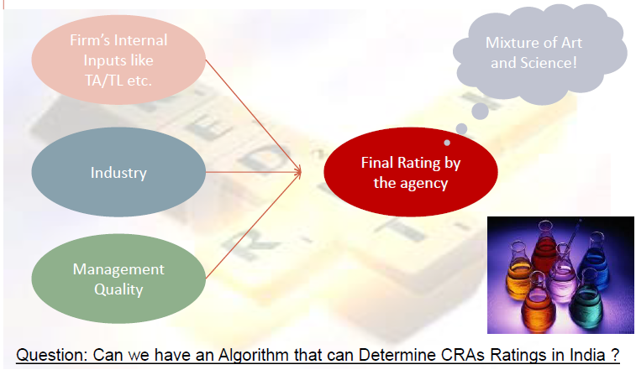
How is Rating
Determined in CRAs ?

Slide 20
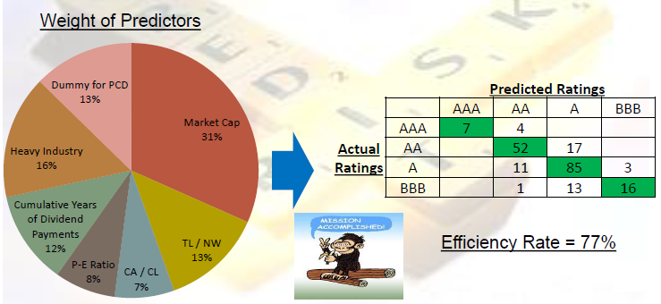
Developing CRA’s
Rating Algorithm
•Developing Ordered-LogitRegressions with Market Information ( Incorporated market information into the logic)

Slide 21
Recap –What we Studied
•Discriminant Models though Accurate has ‘High Maintenance’
•Logit/ ProbitRegressions display stability than Discriminant Models
•The Strength of the Tool is a Function of the Quality of Data used for the Analysis
•Credit Rating tries to resolve Information Asymmetry in assigning the Right Price of Debt
•Either Tool can be used to develop an Independent Rating Framework

